Slide 1

THE DISAGREEMENT PROBLEM IN XAI ON IMAGE DATA VIA SALIENCY MAPS
University of Science
Honors Program, Faculty of Information Technology
Supervisor: Prof. Dr. Le Hoai Bac
Reviewer: MSc. Le Ngoc Thanh
Students: Mai Duy Nam - 19120298 Nguyen Huu Binh - 19120460

Slide 2
Contents
1. Introduction
2. Problem
3. Objective
4. Approach
5. Experiments
6. Results
7. Conclusion
8. Limitations and Future Works

Slide 3
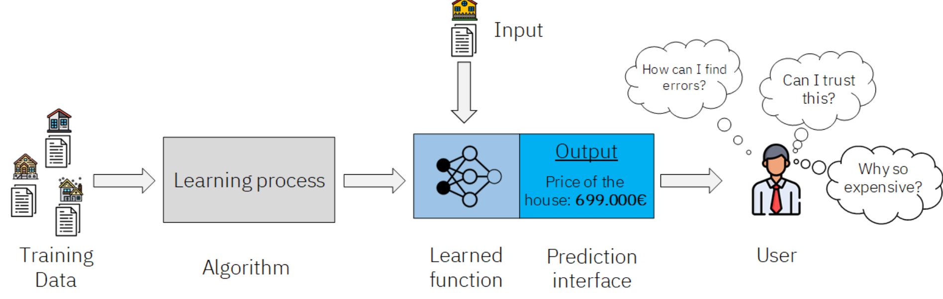
Introduction – eXplainable AI
What is Explainable AI? Concepts & Examples
eXplainable Artificial Intelligence (XAI) has become crucial in high-stake domains like healthcare and security due to the use of complex deep learning models.

Slide 4

Problem
XAI methods produce inconsistent and contradictory explanations, which makes AI practitioner confused when use them to explain models

Slide 5
Literature Review
The Disagreement Problem in Explainable Machine Learning: A Practitioner’s Perspective
Krishna, Satyapriya et al. 2022
Use some set-based metrics to analyze how often such disagreements occur in practice on multiple tasks.
Conduct a user study to see how practitioners deal with disagreements between post-hoc explainers:
84% participants reported encountering the disagreement problem in their day-to-day workflow
86% of responses indicated that ML practitioners either employed arbitrary heuristics (e.g., choosing a favorite method) or just simply did not know how to resolve the disagreement problem.

Slide 6
Literature Review
Disagreement amongst counterfactual explanations: How transparency can be deceptive
Brughmans, Melis et al. 2023
Large-scale empirical analyses on 40 tabular datasets, yielding over 192,0000 explanations generated.
Confirm the existence of the disagreement problem amongst different counterfactual explanation algorithms
Conclude that the size of the disagreement problem is highly dependent on the dataset and counterfactual methods used and not so much on the classifier used

Slide 7
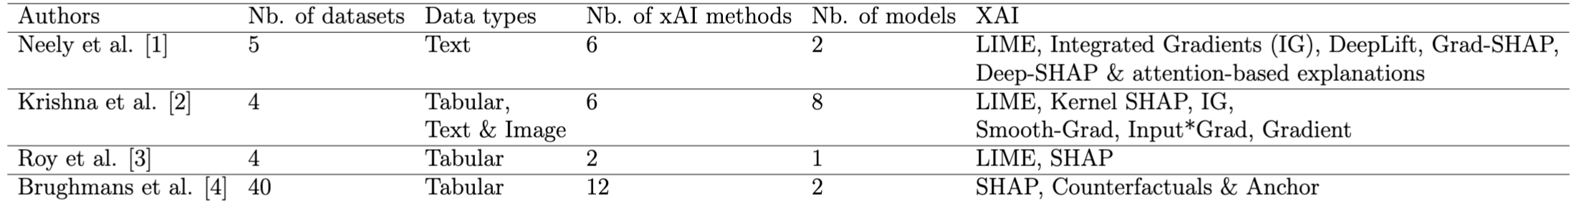
Literature overview
[1] "Order in the court: Explainable AI methods prone to disagreement". 2021
[2] "The disagreement problem in explainable machine learning: A practitioner’s perspective". 2022
[3] "Why Don’t XAI Techniques Agree? Characterizing the Disagreements Between Post-hoc Explanations of Defect Predictions". 2022
[4] "Disagreement amongst counterfactual explanations: How transparency can be deceptive". 2023
Notes:
[1]
Used-models: LSTM-based Model, DistilBERT
[2]
For tabular data, they train four models: a logistic regression model, a gradient-boosted tree model (50 estimators), a random forest model (50 estimators), and a densely-connected feed-forward neural network (with 4 hidden layers with relu activation consisting of 50, 100, 100, and 50 neurons, respectively). Use COMPAS dataset. The test accuracies of the four models are 0.84, 0.83, 0.82, and 0.84 respectively
For text data, they trained a widely-used LSTM-based text classifier. The model performs with 90.67% accuracy
For image data, they use the pre-trained ResNet-18 model. This model performs 69.758 % and 89.078 % on Accuracy@1 and Accuracy@5 metrics
[3]
Used-models: Random Forests
Used-metrics: Feature Agreement (FA), Rank Agreement (RA), Sign Agreement (SA)
[4]
Used-models: a Random Forest classifier (RF) and an Artificial Neural Network (ANN).
Used-methods: 10 counterfactual algorithms, Anchors, and SHAP

Slide 8
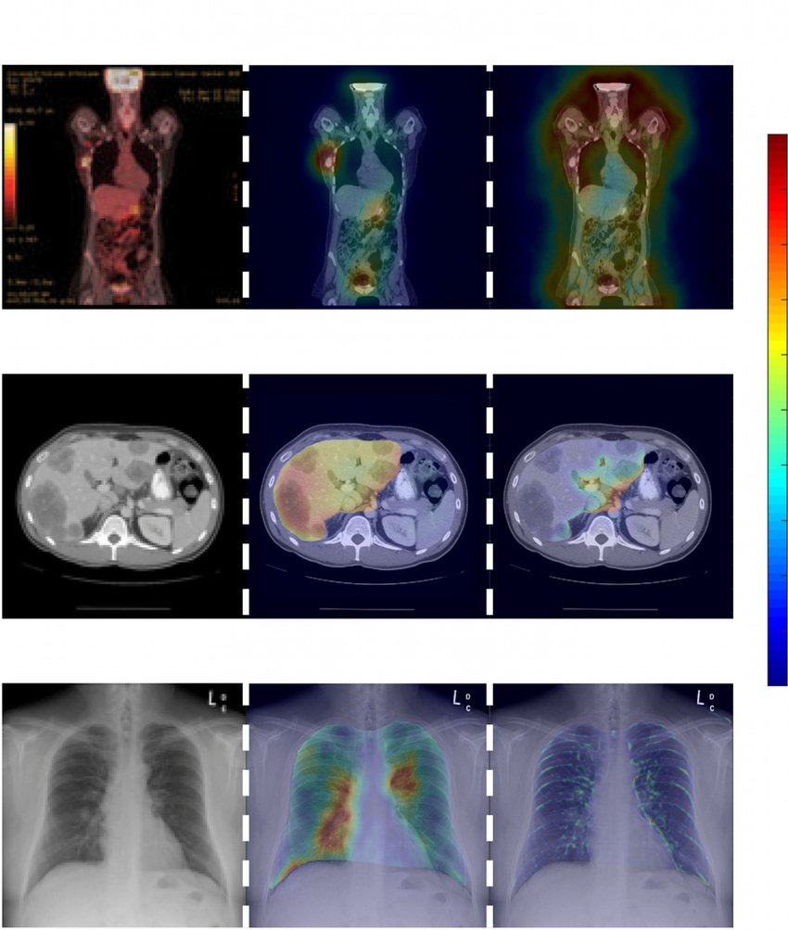
Saliency maps
Saliency maps is the most popular approach when explaining results in computer vision tasks
Visualize explanations by highlighting which parts in input data with regarding to the extent it impact the output
Comparative study of computational visual attention models on two-dimensional medical images

Slide 9

Objectives
Objective 01
Assess the extent of disagreement between saliency methods in medical field when it comes to classifying X-ray images.
Objective 02
Shedding light on different aspects of the disagreement problem.

Slide 10
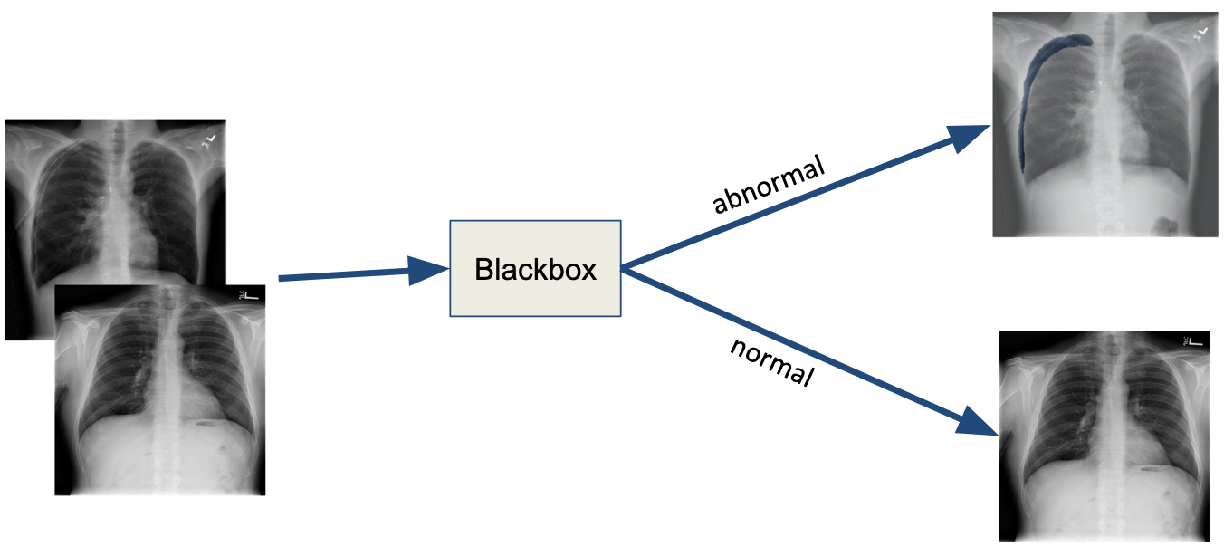
Chest X-ray Classification Task
Classify which X-rays showing signs of Pneumothorax or Pneumonia

Slide 11
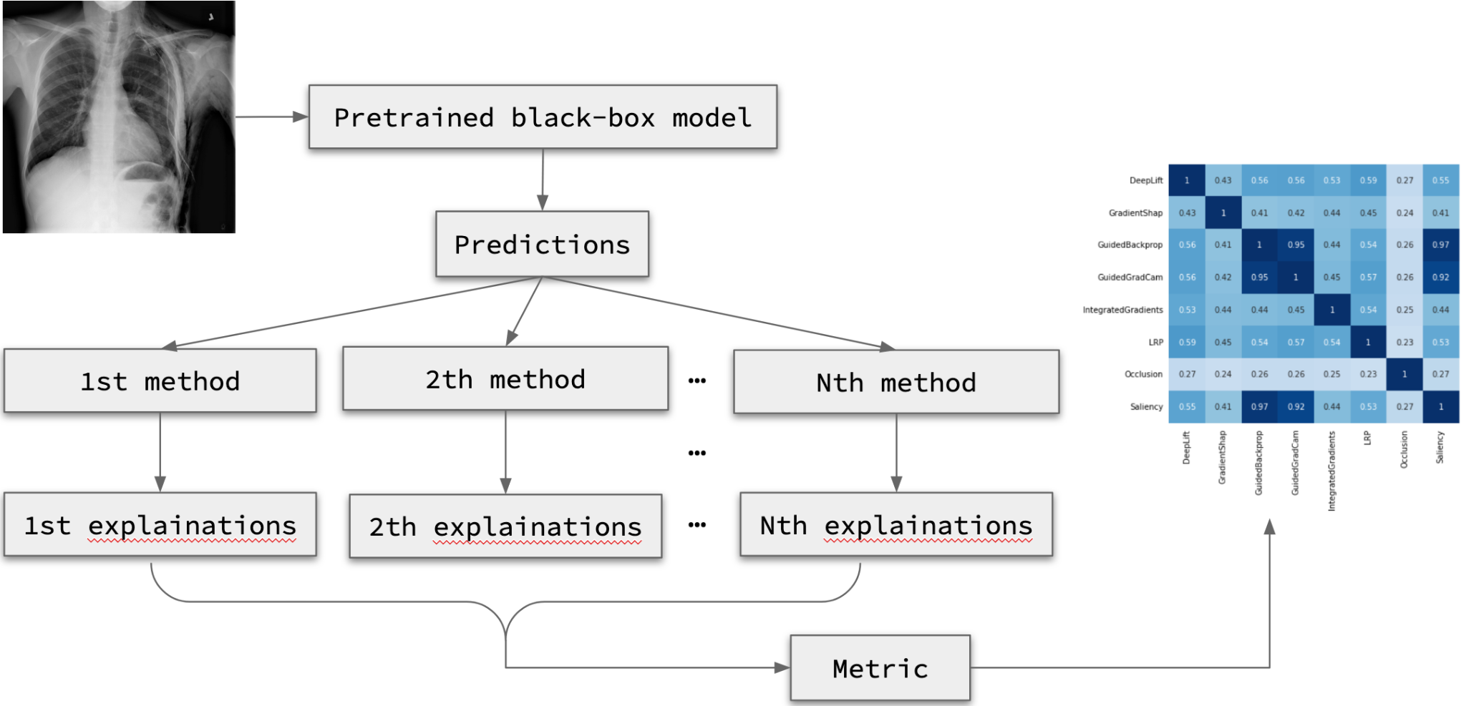
Approach

Slide 12
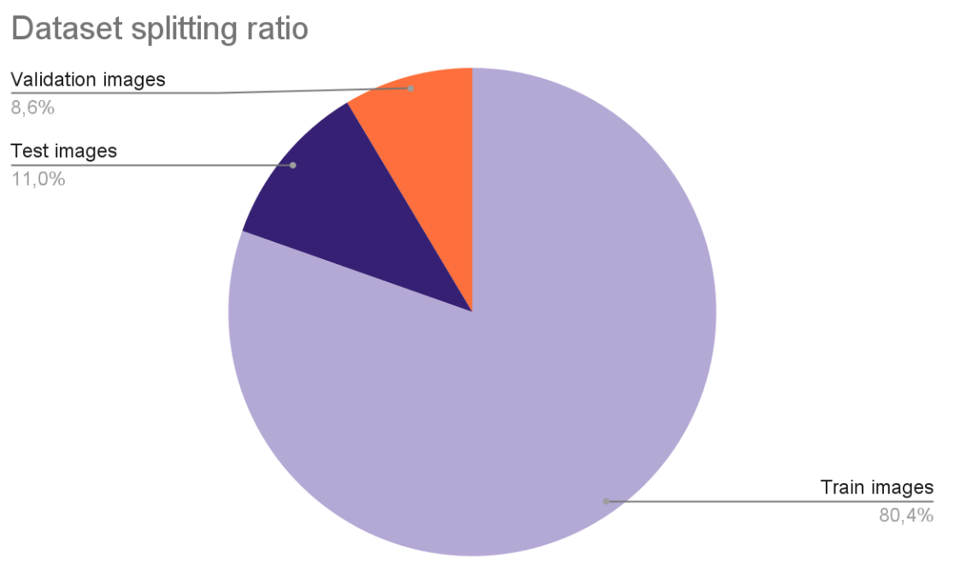
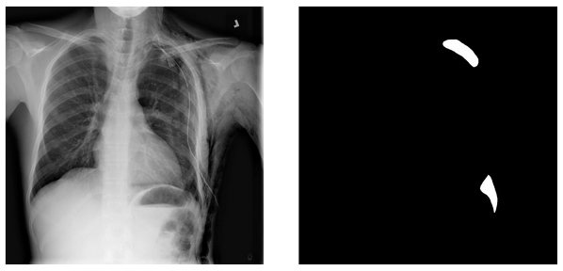
Dataset
SIIM-ACR Pneumothorax Segmentation
The training data of the Kaggle SIIM-ACR Pneumothorax Segmentation competition
Contains more than 12k images/masks
Notes:
SIIM (hiệp hội tin học hình ảnh trong y học) và ACR (hiệp hội xquang Mỹ)

Slide 13
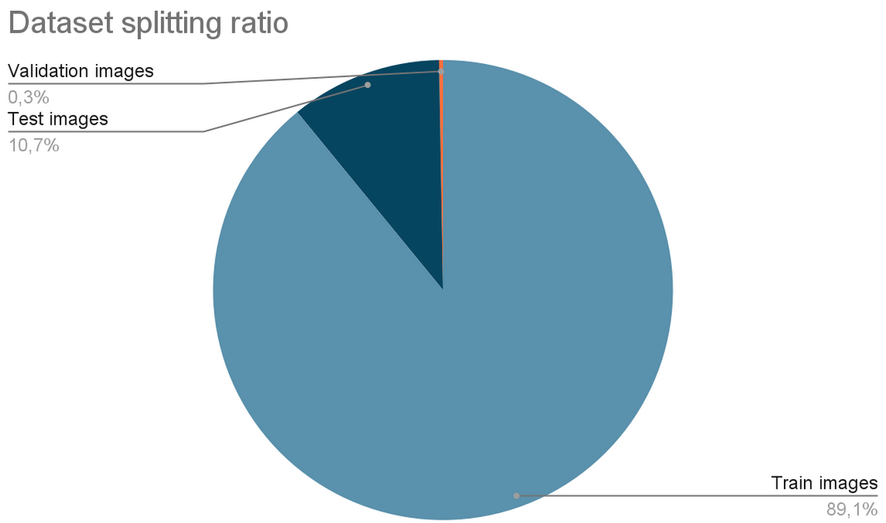
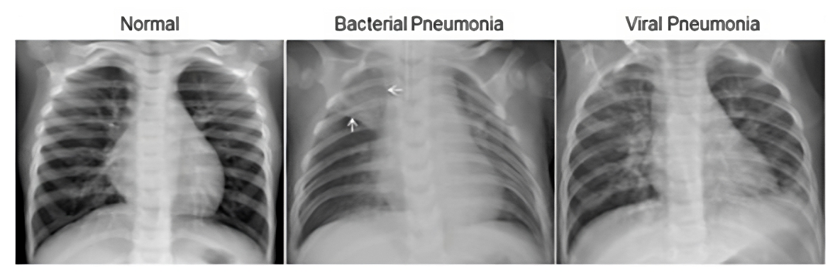
Dataset
Pneumonia Classification
5,863 X-Ray images (JPEG), were selected from retrospective cohorts of pediatric patients of one to five years old from Guangzhou Women and Children’s Medical Center.

Slide 14
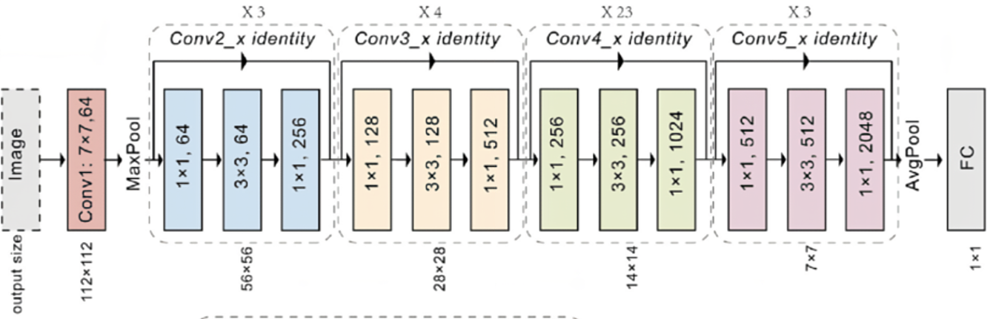
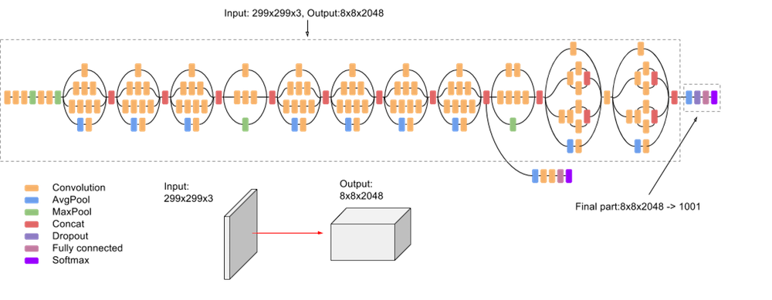
Models
ResNet101
CNN Architecture
Is black-boxes' architecture a factor affecting the extent of disagreement?
Medium size but good performance on similar tasks
InceptionV3
Notes:
Two models have demonstrated good performance on Covid19 detection of coronavirus disease (COVID-19) using X-ray image task in the paper: https://pubmed.ncbi.nlm.nih.gov/33994847/

Slide 15
Models - ResNet101
Address the challenge of training very deep neural networks (overfitting & performance degrading) by utilizing residual connections
By propagating gradients through these shortcuts, the model can effectively capture residual information and learn more efficiently​

Slide 16
Models - InceptionV3
Addresses the problem of overfitting that arises when using very deep neural network by employing parallel layers of multiple filter sizes at the same level

Slide 17
XAI Methods
Experiment on 8 popular used methods
GRADIENT-BASED METHODS
PERTURBATION-BASED METHODS
Saliency, Integrated Gradient, LRP, DeepLift, Guided GradCAM, GradientSHAP, Guided Backprop
Occlusion
Notes:
Saliency-based explainer is defined as methods provide the image region that CNN models pay attention to make predictions in https://arxiv.org/pdf/2106.12773.pdf

Slide 18
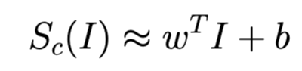
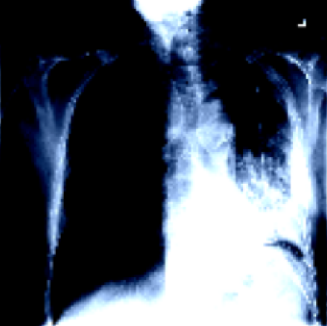
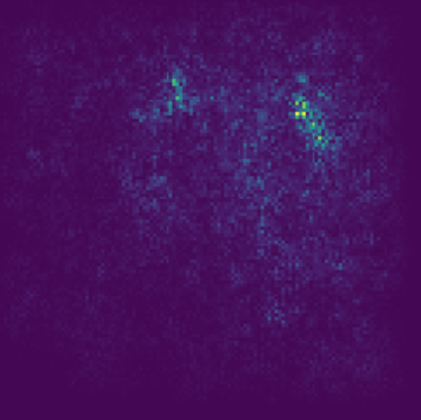
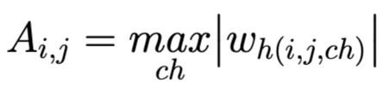
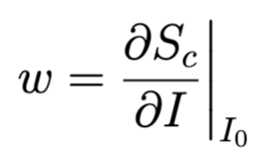
Saliency / Vanilla Gradient
Given an image I0, we can approximate the class score Sc(I) with a linear function
Then, calculate the saliency map A
because
With the weight w is calculated by
Is pneumothorax

Slide 19
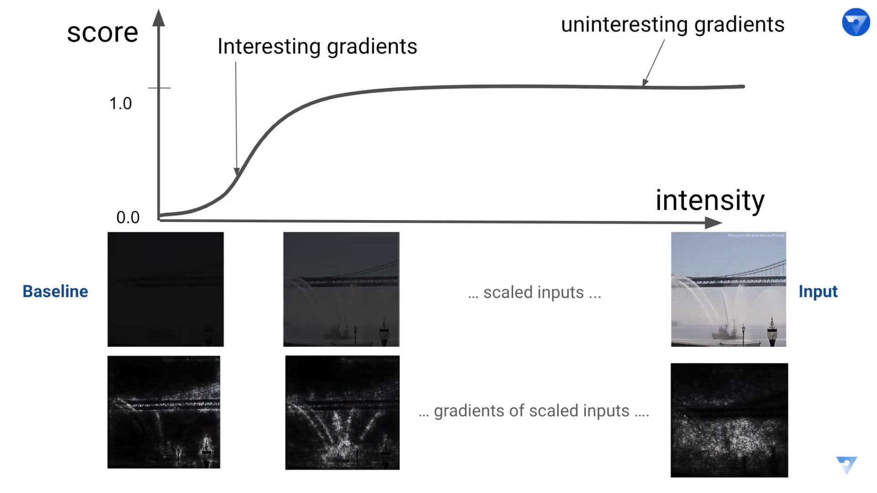
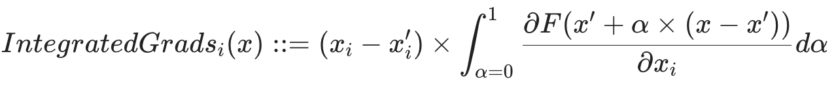
Integrated Gradient
The contribution of feature i-th calculated as follow:

Slide 20
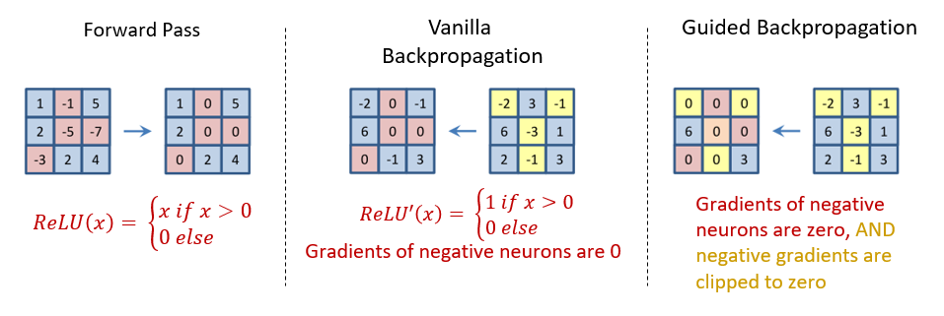
Guided Backpropagation
Negative gradients could decrease the accuracy of deeper layers in the network being explained
Modifies the standard backpropagation step using the ReLU operation, allowing only positive gradients to be backpropagated.

Slide 21
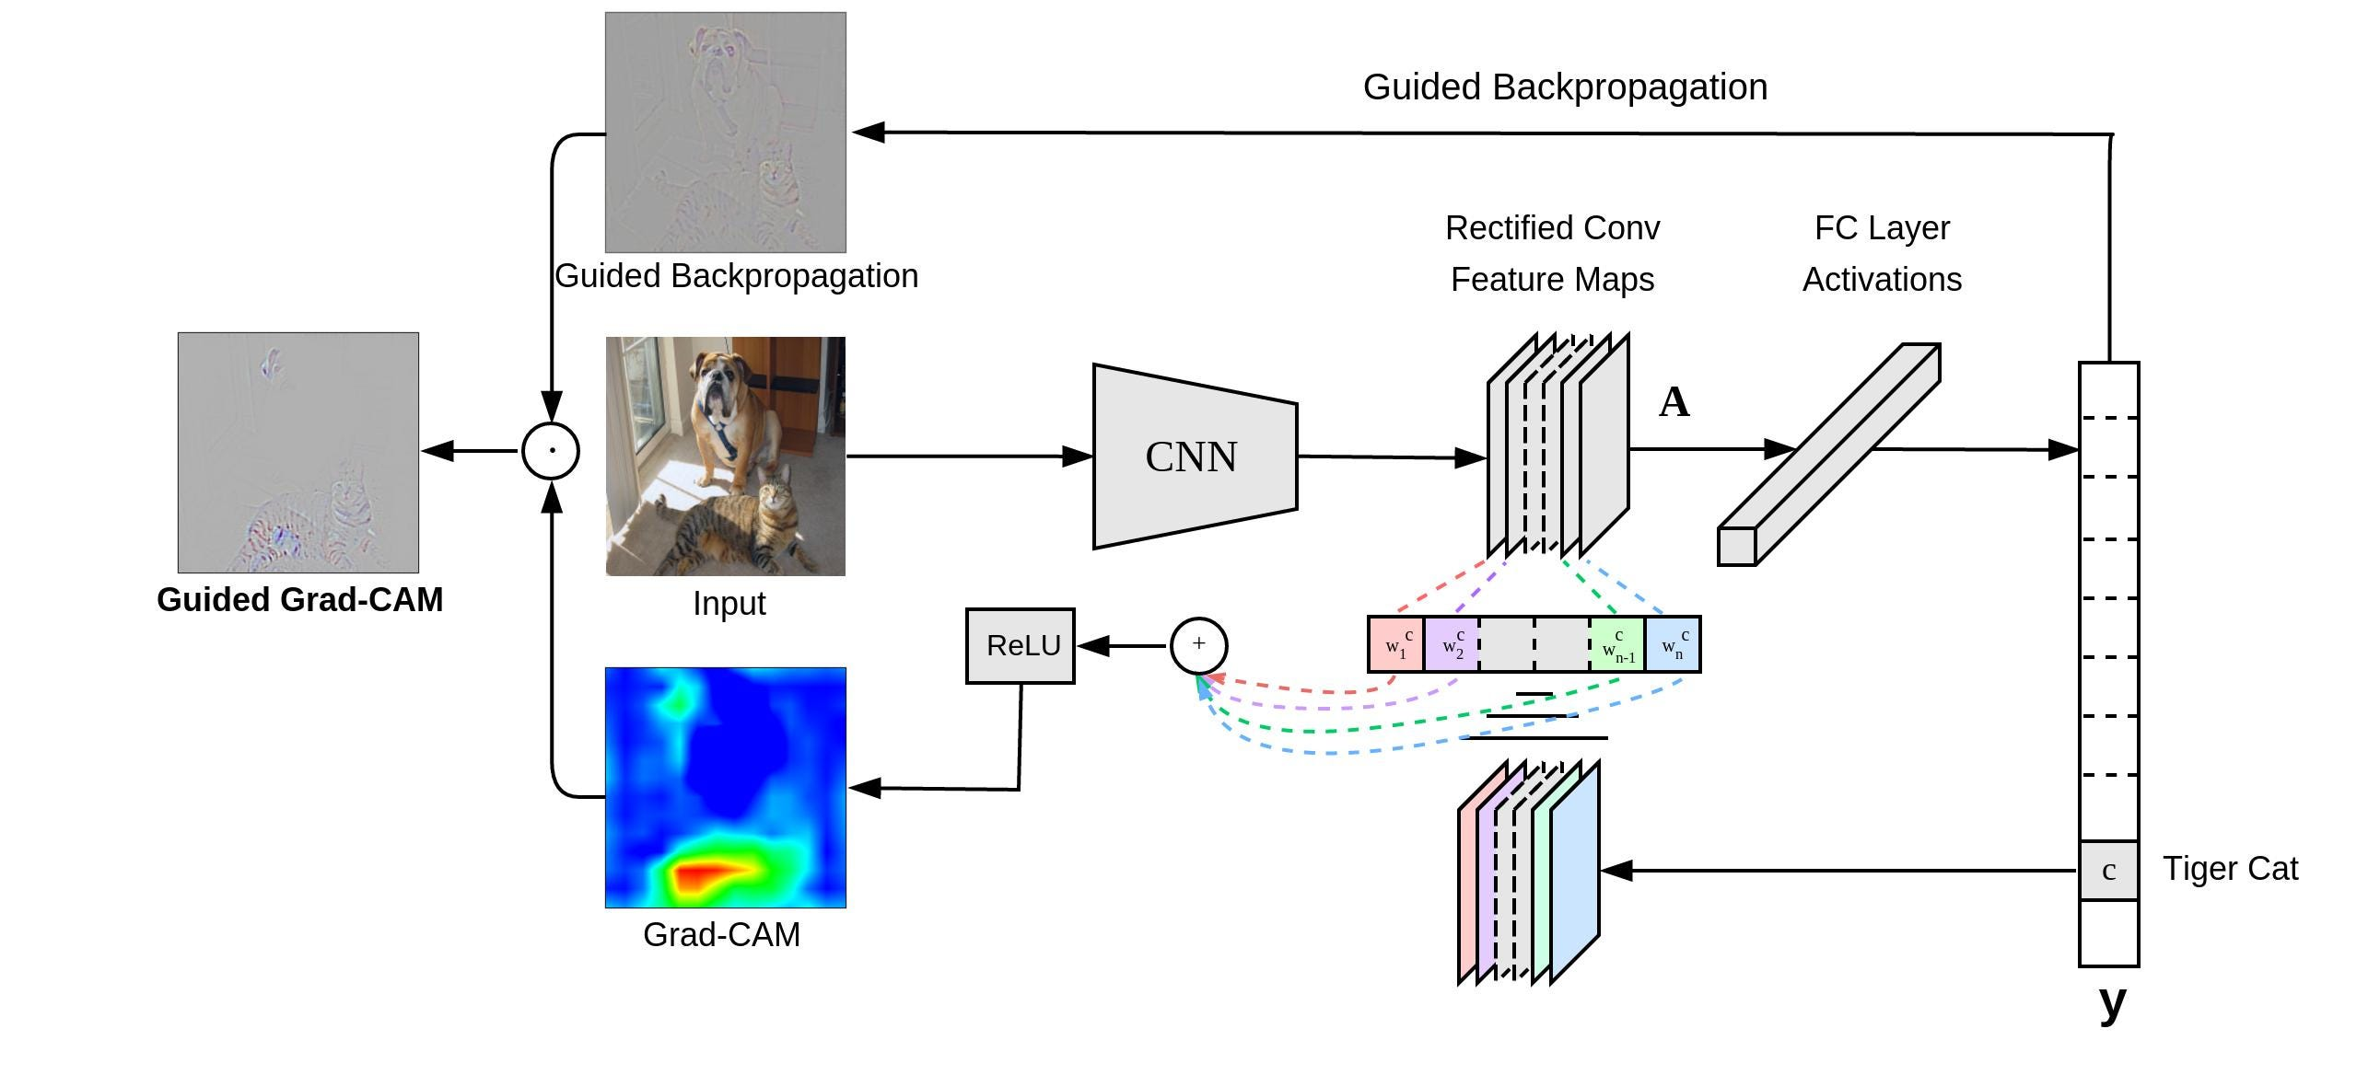
Guided GradCAM
Focus on regions where positive gradient
Class discrimination, localization
How Guided Gradient-CAM works
Notes:
Grad-CAM (Selvaraju et al., 2016) computes a feature-importance map by associating the feature maps in the final convolutional layer with particular classes based on the gradients of each class w.r.t. each feature map, and then using the weighted activations of the feature maps as an indication of which inputs are most important.
To obtain more fine-grained feature importance, the authors proposed performing an elementwise product between the scores obtained from Grad-CAM and the scores obtained from Guided Backpropagation, termed Guided Grad-CAM.
However, this strategy inherits the limitations of Guided Backpropagation caused by zeroing out negative gradients during backpropagation. It is also specific to convolutional neural networks

Slide 22
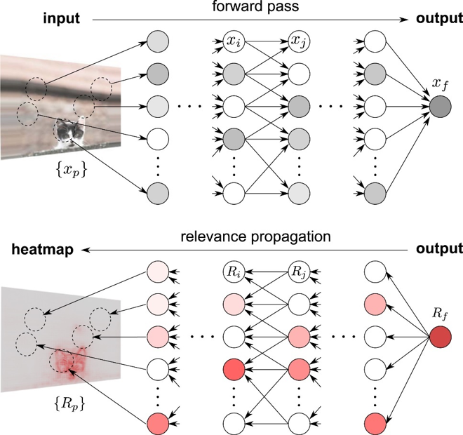
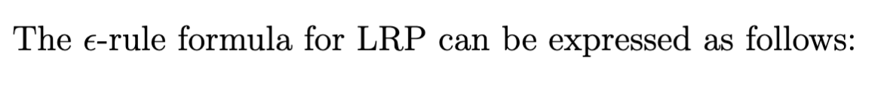
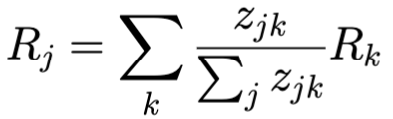
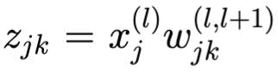
Layer-wise Relevance Propagation
is the amount of contribution node j has to make node k relevant
How LRP works
Notes:
As the name suggests, LRP (Layer-wise Relevance Propagation) is a method that redistributes relevance scores from the output layer to the input layer in a top-down manner.
The basic assumptions and operation of LRP are as follows:
Each neuron has a certain amount of relevance (certain relevance).
Relevance is redistributed from the output layer to the input layer in a top-down manner.
The relevance is preserved during (re)distribution.
One commonly used rule in LRP is the “epsilon rule” which solves the problem of gradient noise by introducing a small positive term

Slide 23
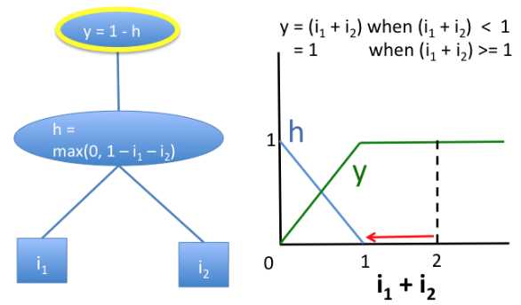
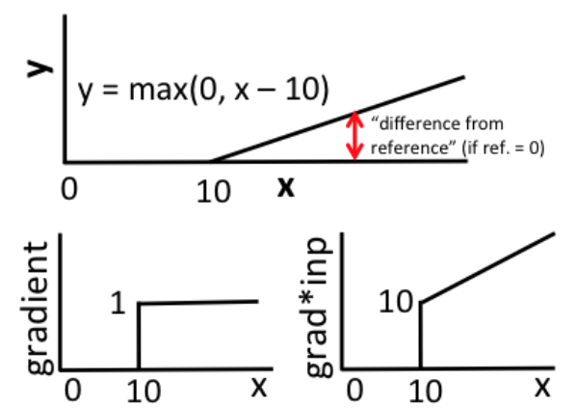
DeepLIFT
Computes the contribution of each input feature to the output by comparing the activation of each neuron in the network to a reference activation.
A simple network exhibiting saturation in the signal from its inputs
Discontinuous gradients can produce misleading importance scores
Notes:
In contrast to most gradient-based methods, using a difference-from-reference allows DeepLIFT to propagate an importance signal even in situations where the gradient is zero and avoids sudden jumps in the importance score over tiny changes in the input caused by discontinuities in the gradient

Slide 24
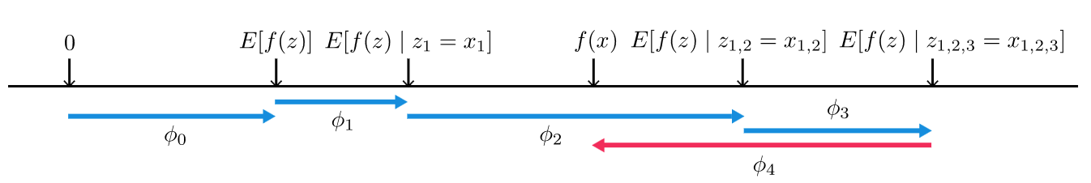
Grad-SHAP
Approximates SHAP values by computing the expectations of gradients by randomly sampling from the distribution of baselines/references
A Unified Approach to Interpreting Model Predictions
Notes:
The gradient-based approach to attribution and the concepts of Shapley values from cooperative game theory

Slide 25
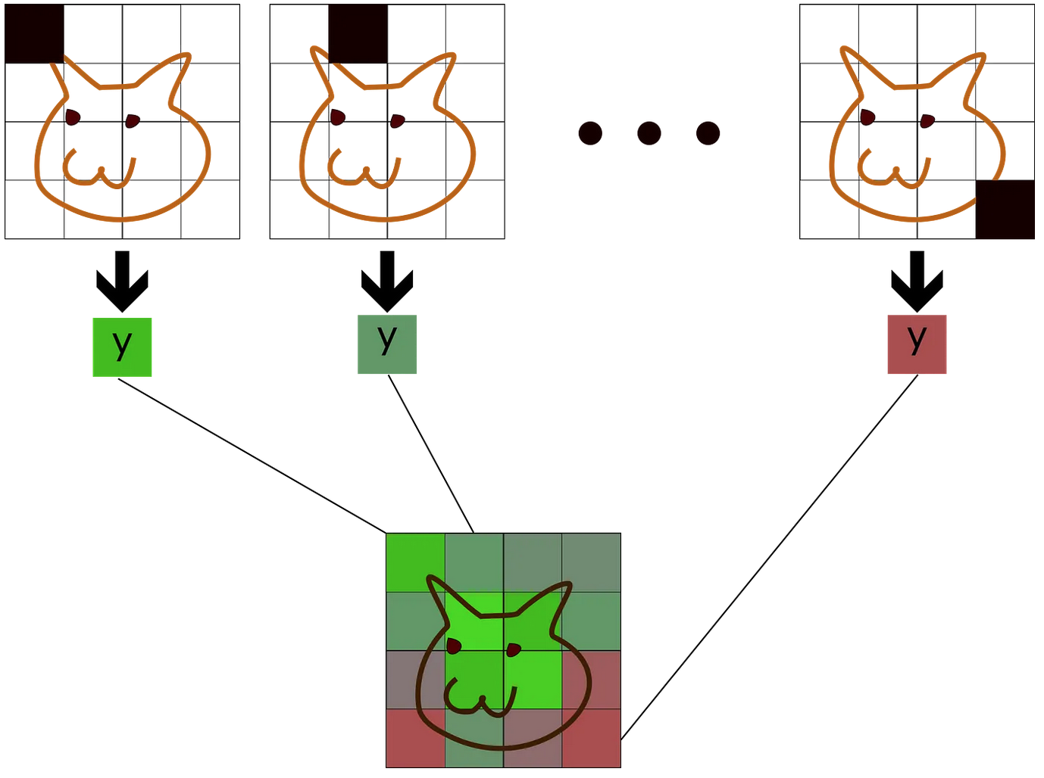
Occlusion
Occlude different regions of the input data and observe the resulting changes in the model’s predictions
Occlusion Analysis for Explaining DNNs

Slide 26
Metrics
Measure how much agreement/disagreement between two saliency maps
Employed four metrics:
Perception-based: Structural Similarity Index (SSIM)
Agreement on top pixels: Feature Agreement and Sign Agreement
Correlation of pixel ranks: Rank Correlation

Slide 27
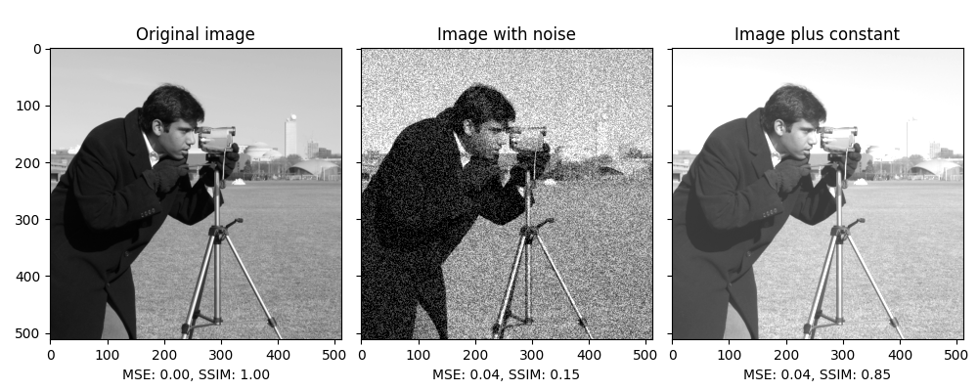
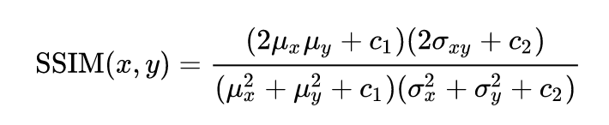
SSIM
Measure the similarity between two images
Capture difference in structure, luminance and contrast
Ranges: [-1, 1]

Slide 28
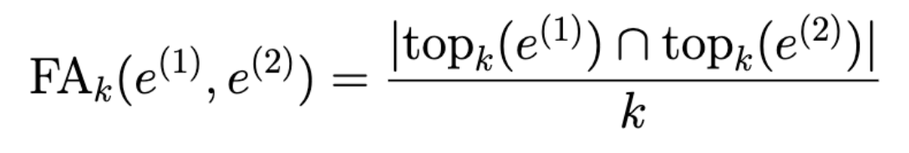
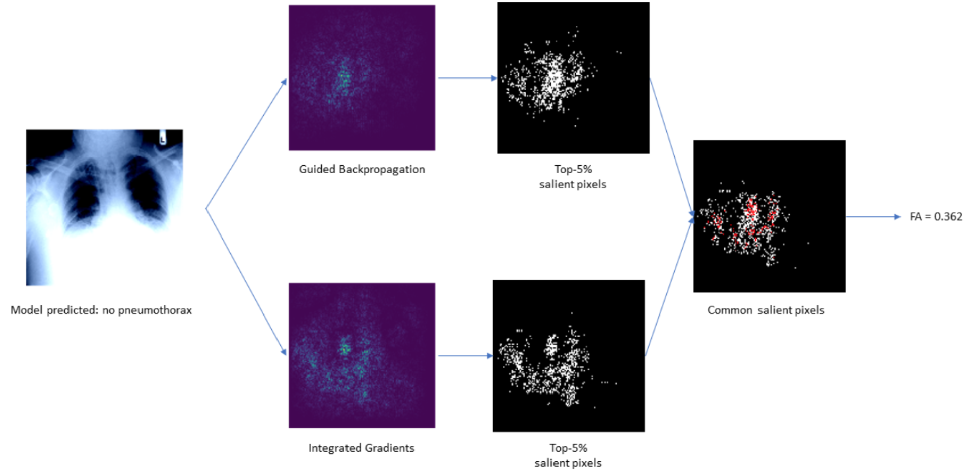
Feature Agreement
Fraction of shared common top pixels
Range: [0, 1]

Slide 29
Sign Agreement
Fractions of shared common top features and contribution sign
Range: [0, 1]

Slide 30
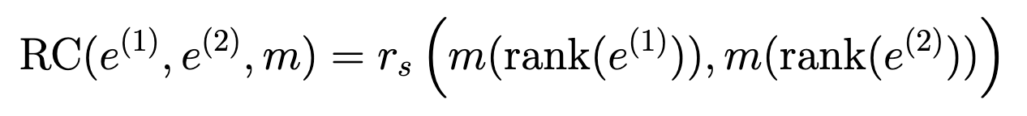
Rank Correlation
Spearman’s rank correlation between the ranks of the pixel values
Correlation coefficient is computed with respect to a subset of interested pixels
For Pneumothorax dataset, we use the pneumothorax mask as interested region
Range: [-1, 1]

Slide 31
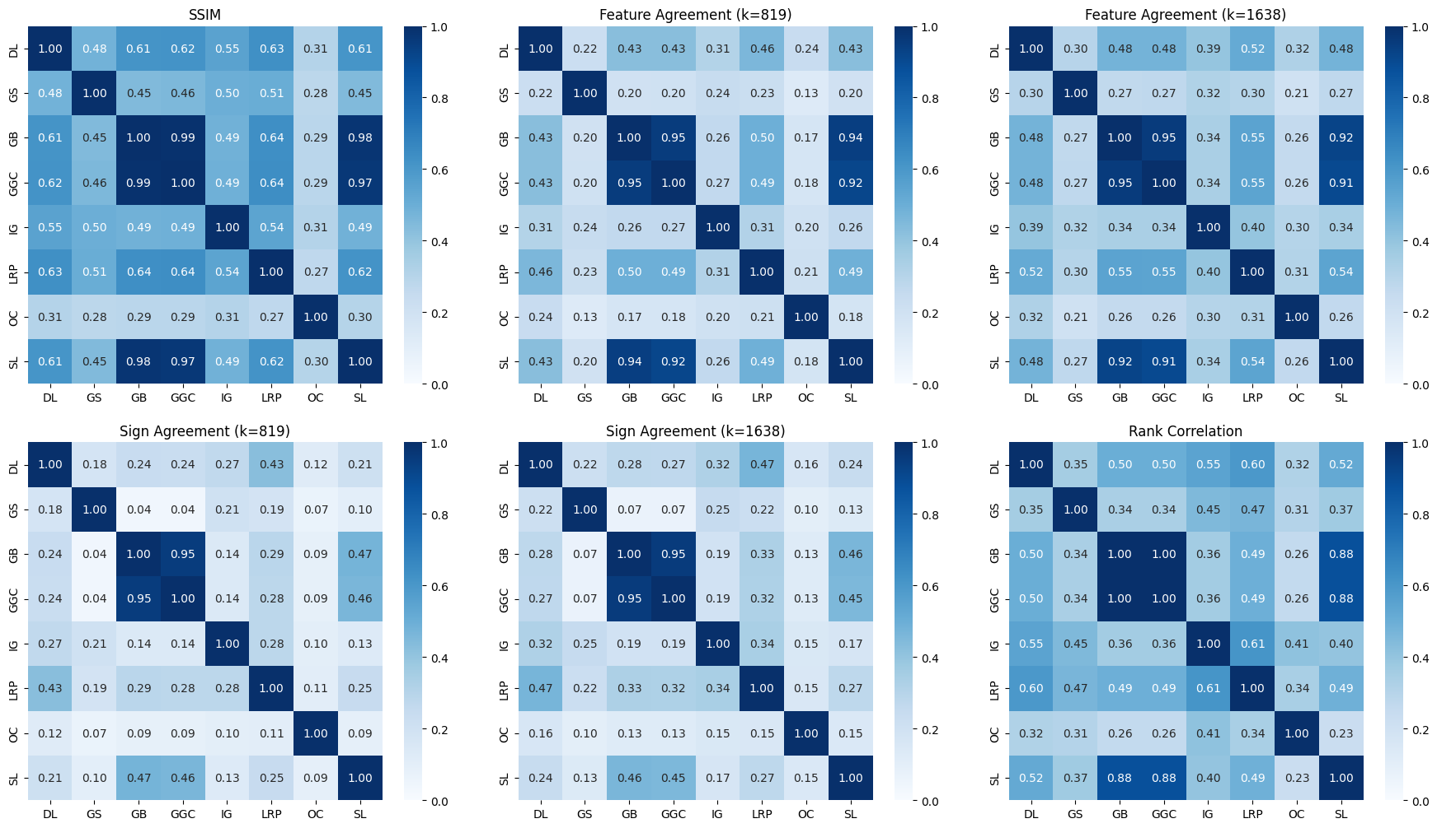
Result Overview
The disagreement heatmaps across different metrics, evaluated for InceptionV3 on Pneumothorax dataset.

Slide 32
Overview
Overall, there are different levels of disagreement among the pairs of explanation methods
The methods
Are relatively similar in structure (SSIM scores are high)
Disagree the most on sign agreement (this metric has strict conditions)

Slide 33
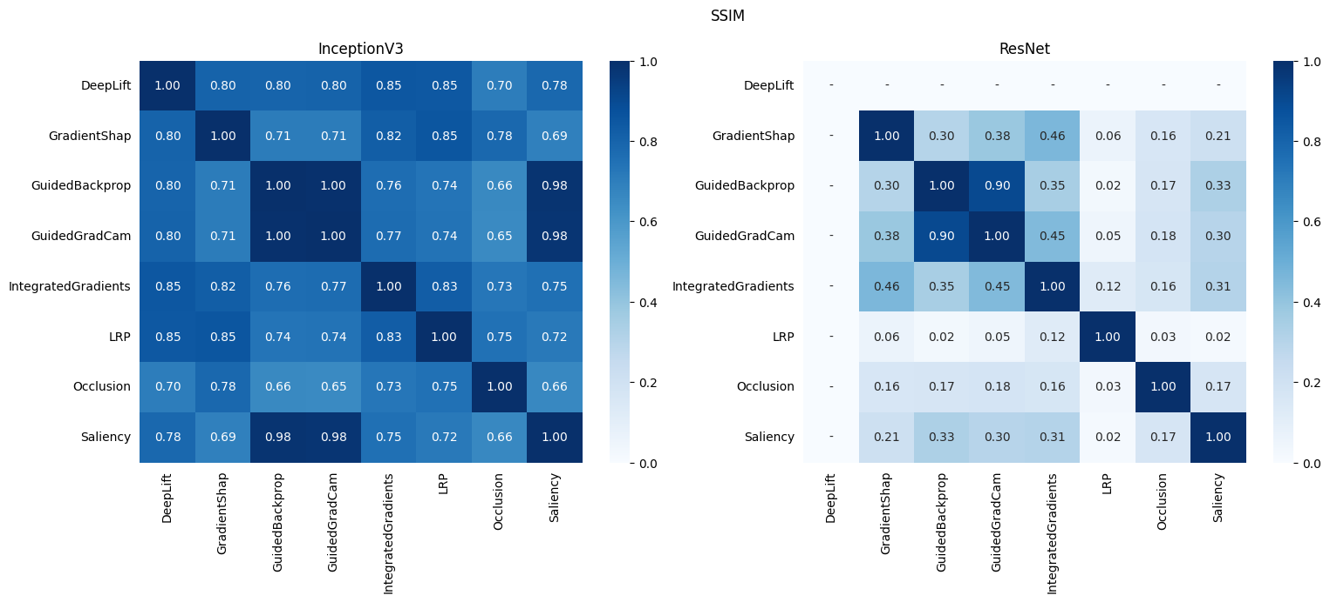
InceptionV3 vs. ResNet101
In general, explanation methods disagree with each other more when explaining for ResNet101 than when explaining for InceptionV3.
The results are consistent with all datasets and metrics.
Comparison of SSIM scores for InceptionV3 and ResNet when evaluating on Pneumonia dataset.

Slide 34
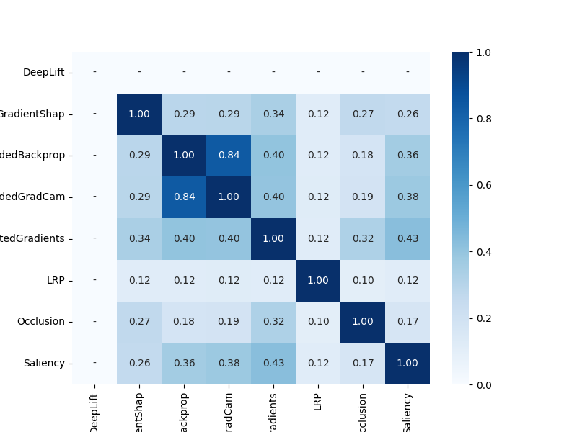

Pneumothorax vs. Pneumonia
However, the level of disagreement remains consistent for all metrics (except SSIM) when explaining for the same black box, regardless of the data
This means the architecture of the black box has higher influence on the decisions of the explanation methods
(a) Feature agreement score of ResNet evaluated on Pneumothorax dataset.
(b) Feature agreement score of ResNet evaluated on Pneumonia dataset.

Slide 35
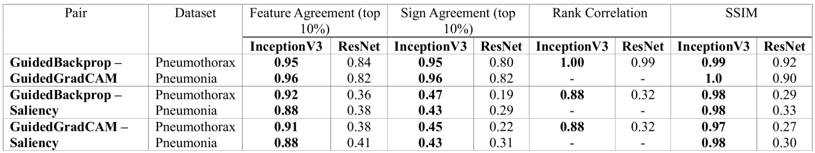
Patterns of disagreement among pairs
Guided Backpropagation and Guided Grad-CAM are always consistent with each other.
In contrast, the pair Saliency - Guided Backpropagation and Saliency - Guided Grad-CAM are agreeable on InceptionV3 but have higher level of disagreement on ResNet.
Comparison of the metric scores for every pair of the methods Guided Backpropagation, Guided Grad-CAM and Saliency (vanilla gradient).

Slide 36
Remarks
Explanation methods have different goals, different computational operations and meanings in their output feature importance scores:
LRP redistributes relevance scores backward through the layers of the neural network based on conservation property
Integrated Gradients takes line integral of the change in outputs when the inputs change from a default baseline
Guided Backpropagation (GB) and Guided Grad-CAM (GGC) are similar because GGC multiply GB’s positives gradients elementwise with Grad-CAM weights.
The range of feature importance scores are different:
Gradient-based methods output both negative and positive scores
Occlusion only outputs positive scores

Slide 37
Conclusion
Show that there exists disagreement among the experimented methods
Different pairs show different degrees of disagreement
Guided Backpropagation and Guided Grad-CAM are most similar to each other
Levels of disagreement change with the type of black box, but not the dataset

Slide 38
Limitation and Future Works
Limitations:
Not clear explanations for why the methods disagree
Small scale experiments
Future works:
More in-depth analysis on the reasons for disagreement
Experiment with more blackboxes
Develop and test with more robust metrics that can capture other aspect of disagreement

Slide 39
THANK YOU

